Slide 1



Data Analytics on Machine Learning performance

Slide 2

INDEX
1
Project description & Objective
2
Methodology and Technology
3
Technical implementation
4
Achieved results
5
Possible future implementations

Slide 3
Introduction
1
Project description & Objective

Slide 4
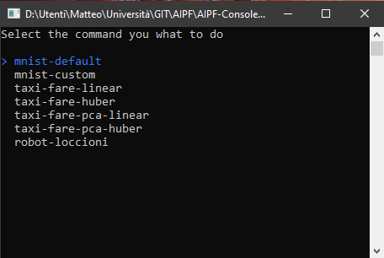
AIPF System
Project description
A system that allows the company to integrate Machine Learning Algorithms, for each industrial machine used, in a simple way.

Slide 5
OBJECTIVE
Analyze in real time the diagnostic of the AIPF system, extending it, in order to understand what is the best model.

Slide 6
ROADMAP
Analysis of available Diagnostic libraries
Model performance understanding
Implementation of OpenTelemetry Collector and Elastic Stack
1
3
5
2
4
6
Study of OpenTelemetry, OT Collector and OT Protocol
Implementation of OpenTelemetry in AIPF
Analysis with ElasticSearch

Slide 7
Methodology and Technology
2
System architecture & frameworks

Slide 8
System division
Core
The core is used to define some ML pipeline and models
Diagnostic
Is related to collecting telemetries about the system

Slide 9





FRAMEWORKS
Elastic Search
The fast and scalable search and analytics engine at the heart of the Elastic Stack
Kibana
User interface for Elasticsearch data visualization and navigation
APM Server
Receives data from APM Agents and transforms them into ElasticSearch document
Open Telemetry SDK
.NET library integrated into the AIPF System
Open Telemetry Collector
The OT collector used to receive, process and
export telemetries data

Slide 10
Technical implementation
3
Workflow

Slide 11
Workflow
Kibana
Data visualization tool
ElasticSearch
NoSQL database
APM Server
Collector for ElasticSearch
OpenTelemetry Collector
Collector for OpenTelemetry
OTEL Agent
Data exporter for matrics, traces and logs
AIPF
System CORE

Slide 12
AIPF
TRAIN
PREDICT
EVALUATE
Model_name
Processed_elements
Input_type
Output_type
FIT
...
FILTER
TRANSFORMATION

Slide 13
AIPF & OTEL Agent
AIPF
The system workflow begins with the data production by the Core.
OTEL Agent
We collect the data and then send to the Collector.
Kibana
ElasticSearch
APM Server
OpenTelemetry Collector
OTEL Agent
AIPF

Slide 14
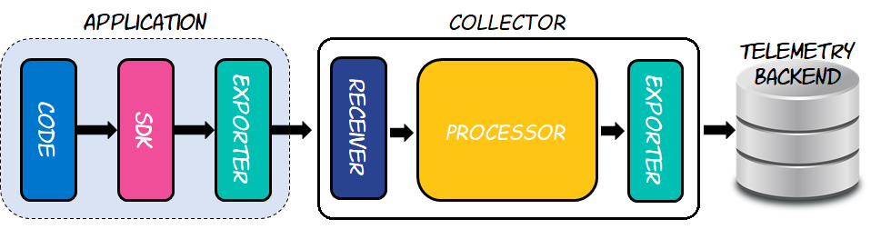
Open Telemetry Collector
Kibana
ElasticSearch
APM Server
OpenTelemetry Collector
OTEL Agent
AIPF

Slide 15
Elastic Stack
(APM Server + ElasticSearch + Kibana)
Elastic Stack
Receive data from Open Telemetry Collector and saved inside Elastic; then we analyze them using kibana.
Kibana
ElasticSearch
APM Server
OpenTelemetry Collector
OTEL Agent
AIPF

Slide 16
Achieved results
4

Slide 17
We are going to analyze the model’s performances in typical activities of a ML model (Train, Predict and Evaluate)

Slide 18
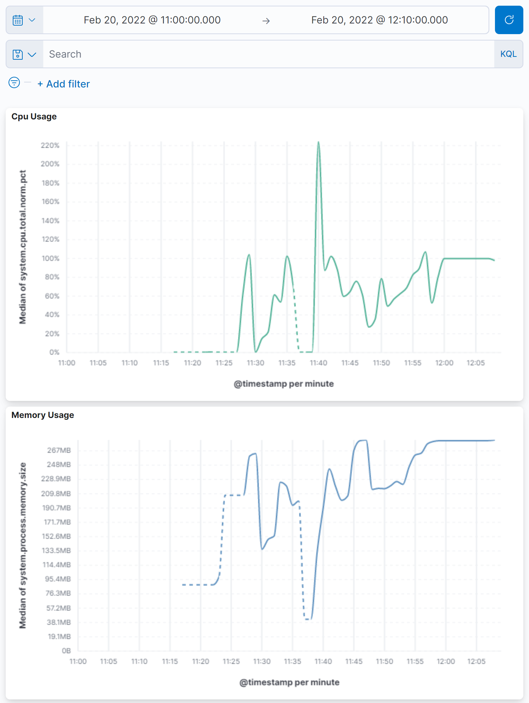
Main Dashboard
Shows the main performance of the system

Slide 19
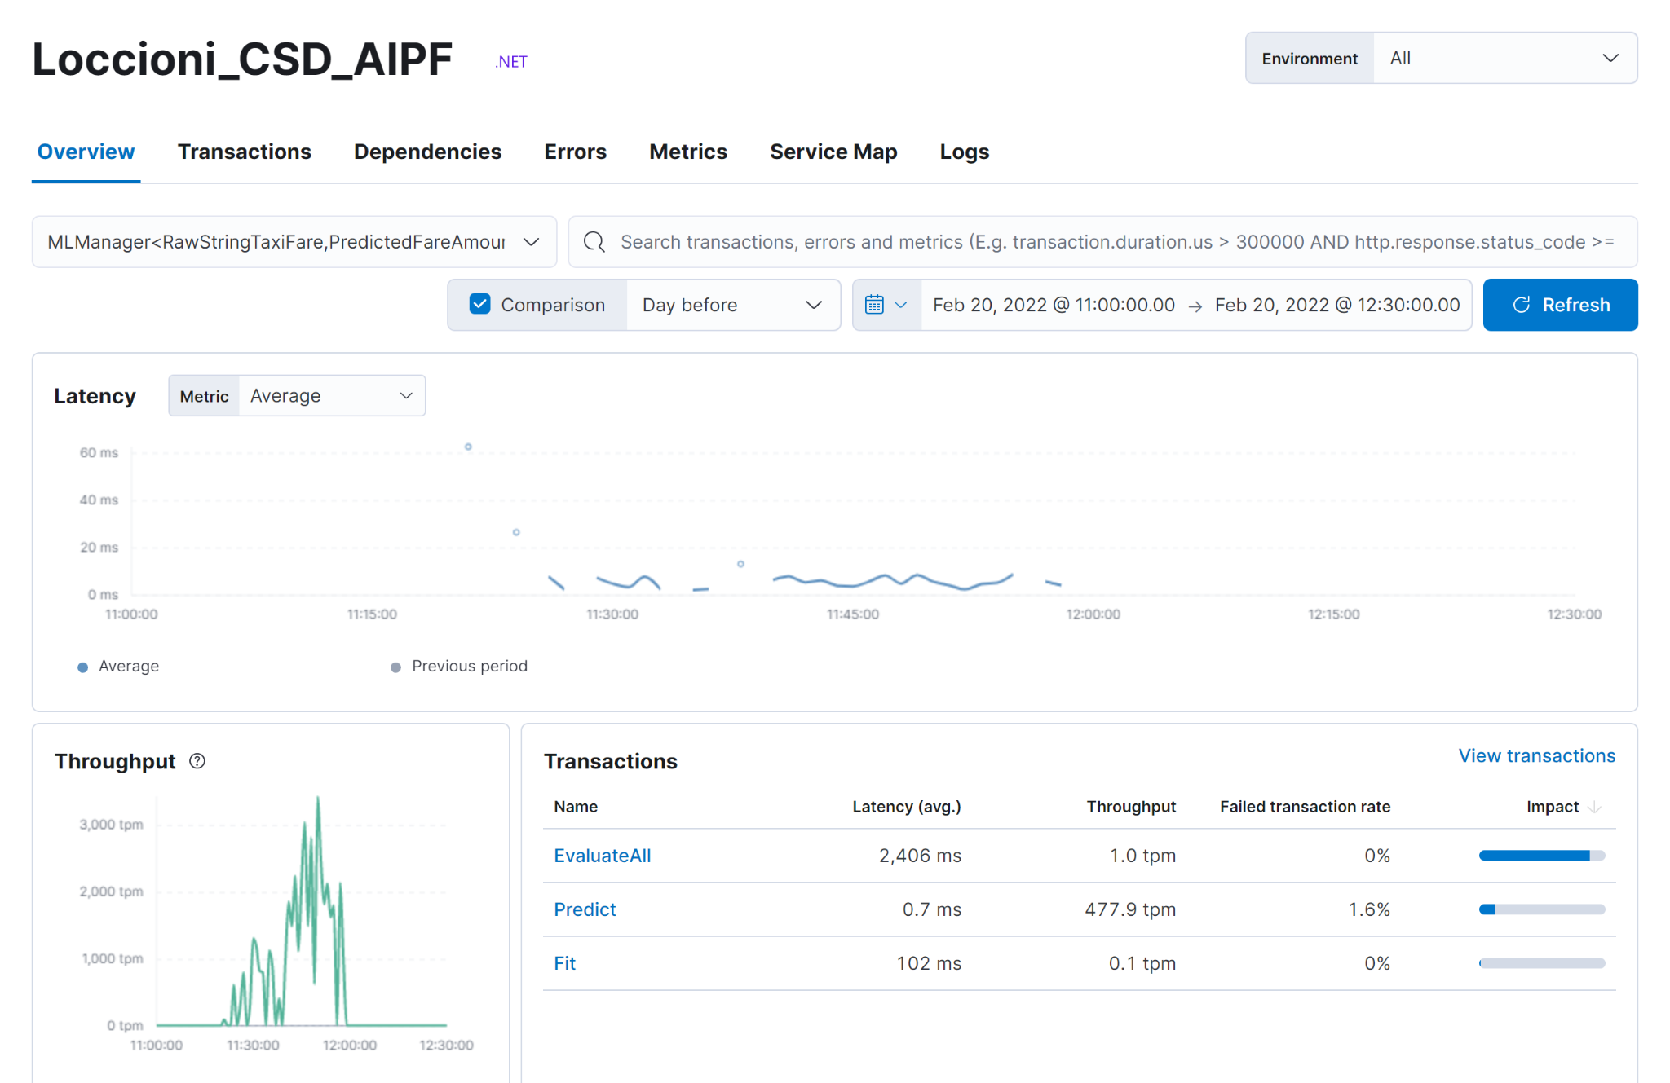
APM Dashboard
Overview of APM service

Slide 20
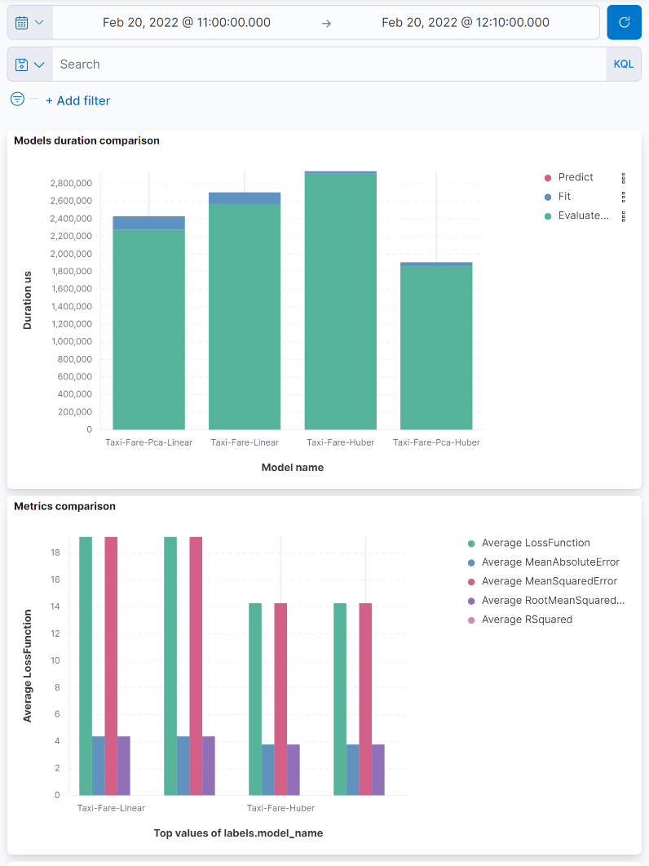
TaxiFare Dashboard
Shows the comparison between the TaxiFare models

Slide 21
Possible future implementations
5
Conclusion

Slide 22
CONCLUSION
The integration of OpenTelemetry with our system is limited.
Some further improvements are:
Add logs inside the AIPF system;
Add metrics about the states of the pipeline (ex: progress indicator);
Add more specific metrics about CPU, Memory, Network…

Slide 23



TEAM
Damiano Cacchiarelli
Roberto Cesetti
Matteo Romagnoli

Slide 24

THANKS!
GitHub
You can find us at:
damiano.cacchiarelli@studenti.unicam.it
matteo02.romagnoli@studenti.unicam.it
roberto.cesetti@studenti.unicam.it

